Slide 1
Text Analytics Demo
Webscrapying, Autophrase

Slide 2
Outline
Webscrapying using Scrapy and Selenium
Wikipedia Infobox Crawler
Linkedin Profile Crawler
Text Mining - Phrase Extraction
Autophrase

Slide 3
Introduction to Scrapy
Link: https://docs.scrapy.org/en/latest/intro/tutorial.html
An application framework for crawling websites and extracting structured data
Python-based
Scrapy v.s. Other python-based web scraping libraries (e.g. BeautifulSoup, LXML, Requests, Selenium)?
When it is better to use Scrapy?

Slide 4
Webscrapying using Scrapy
Link: https://docs.scrapy.org/en/latest/intro/tutorial.html
Basic Structure:
Creating a new Scrapy project
Writing a spider to crawl a site and extract data
Exporting the scraped data using the command line
Changing spider to recursively follow links

Slide 5
Scrapy - Examples
Github Link: https://github.com/huangbeidan/scrapy_tutorial_dse203
Two scrapy examples:
Basic example
Wikipedia Infobox Crawler

Slide 6
Scrapy - Basic Example
tutorial/
scrapy.cfg # deploy configuration file
tutorial/ # project's Python module, you'll import your code from here
__init__.py
items.py # project items definition file
middlewares.py # project middlewares file
pipelines.py # project pipelines file
settings.py # project settings file
spiders/ # a directory where you'll later put your spiders
__init__.py

Slide 7
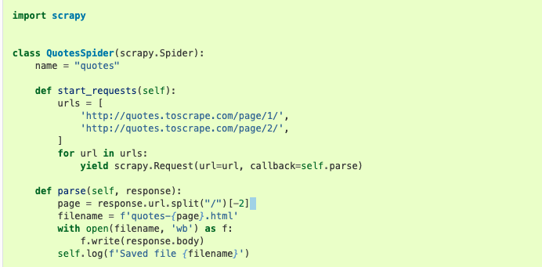
Scrapy - Basic Example

Slide 8
Scrapy - Basic Example - how to run
Github Link: https://github.com/huangbeidan/scrapy_tutorial_dse20
$ scrapy crawl example

Slide 9
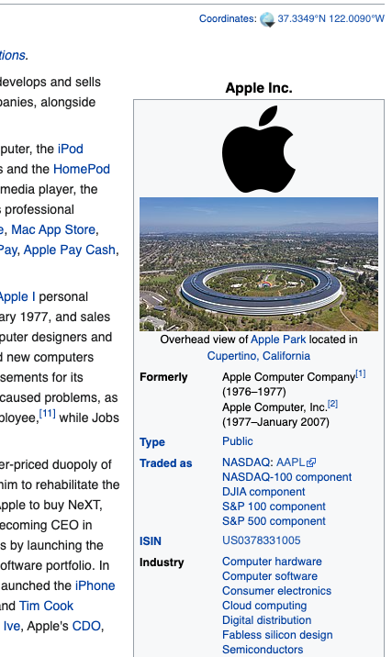
Scrapy - Wikipedia Infobox Crawler
What is an infobox?
Our goal: extract automatically!

Slide 10
Scrapy - Wikipedia Infobox Crawler - Steps
Get a list of company names from csv/database server
Generate Scrapy crawling script
Parse the response (data cleaning, extract relevant information using xpath or other web-parsing libraries)
Save the output

Slide 11
Scrapy - Wikipedia Infobox - Code
Github Link: https://github.com/huangbeidan/scrapy_tutorial_dse20
$ scrapy crawl infobox_spider -o output/info-result.json

Slide 12
Scrapy - Wikipedia Infobox - Code
Github Link: https://github.com/huangbeidan/scrapy_tutorial_dse20
$ scrapy crawl infobox_spider -o output/info-result.json

Slide 13
Web-Scraping with Selenium
Selenium - what is it? What can it do?

Slide 14
Web-Scraping with Selenium
Selenium - a popular automation testing suite which can be used to automate the desktop and mobile web browser interactions

Slide 15
Web-Scraping with Selenium - A practical scenario
Q: We have a project and are interested in people who work as developer US Navy
Information from LinkedIn might be very useful in this case
Title, location, interest, job experiences and etc.
Selenium or Scrapy?
However, a lot of protection these days
We can’t directly tell Selenium to open the search box and type in the query. I’ve tried that, but not works
What’s the solution?

Slide 16
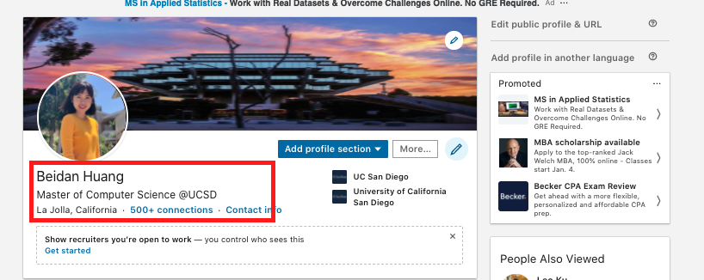
Web-Scraping with Selenium - A practical scenario
Crawl the profile pages from Linkedin for a list of names?

Slide 17
Web-Scraping with Selenium - A practical scenario
Solution:
Step 1: Search the google - site:linkedin.com/in AND "US Navy" AND "developer"
Step 2: Parse the response from google search and extract the urls
Step 3: Ask the driver to go to the extracted urls to do the crawling

Slide 18

Web-Scraping with Selenium - Demo

Slide 19
Phrase Extraction - AutoPhrase

Slide 20
AutoPhrase - Introduction
Github: https://github.com/shangjingbo1226/AutoPhrase
Phrase mining is important in various tasks such as information extraction/retrieval, taxonomy construction, and topic modeling.

Slide 21
Autophrase - Techniques
Robust Positive-Only Distant Training
Leverage existing high-quality phrases from general knowledge base (e.g. Wikipedia)
Minimum human labeling effort
POS-Guided Phrasal Segmentation
Be independent of complex linguistic analyzers while maining language context features

Slide 22
AutoPhrase - how to run
$ ./auto_phrase.sh
Install Dependencies First
Put your corpus file at data directory
Run the shell script in the command line

Slide 23
AutoPhrase - Parameters that you can tune
In auto_phrase.sh
DEFAULT_TRAIN=${DATA_DIR}/EN/[INPUT_FILE]
MIN_SUP=${MIN_SUP:- 8}

